Slide 1
AIOps Sentinel
A Hybrid Framework for Real-time Anomaly Detection and Explainability
COMPUTER SCIENCE AND ENGINEERING

Slide 2
AI-ops Sentinel
Artificial Intelligence for IT Operations (AIOps)
Mohammed Asif Khan R23EA074
Mohammed Raqheebuddin R23EA076
GUIDE-Dr. J Ragaventhiran

Slide 3
Final Review
Abstract
Introduction
  Technology and Domain
  Front End and Back End Details
Literature Survey
Objectives
Methodology
Dataset
Modules Explanation (All modules with demo)
Sample Code and Screenshots of output
Conclusions
Proof of publication / patent / Application Development
Reference
Documentation

Slide 4
1.abstract
Overview: AIOps Sentinel is a real-time framework that detects microservice anomalies using a hybrid ensemble of Isolation Forest and VAE-LSTM models, leveraging SHAP explainability for automated root-cause analysis.
Goal: Automate infrastructure monitoring via an intelligent, end-to-end telemetry pipeline.
Core Logic: Fuses Statistical (Isolation Forest) and Deep Learning (VAE-LSTM) models.
Interpretability: Uses SHAP to provide natural language root-cause attribution.
Scalability: PCA-driven processing of high-dimensional system metrics.
Impact: Drastic reduction in Mean Time to Detection (MTTD) for system faults.

Slide 5
2.introduction
Overview: Modern distributed microservices generate overwhelming telemetry data, making manual oversight and static threshold-based monitoring nearly impossible. AIOps Sentinel addresses this by implementing an autonomous "Sentinel" that learns system behaviors to provide proactive, explainable alerts.
Context: High-velocity metric noise in complex, cloud-native environments.
The Problem: Brittle nature of traditional monitoring systems that fail to detect subtle drifts.
Proposed Solution: An autonomous monitoring agent for self-learning infrastructure health.
Innovation: A hybrid ensemble approach balancing statistical speed with deep-learning precision.
Outcome: A real-time dashboard featuring health scoring and automated remediation runbooks.

Slide 6

3.Technology and domain
The project is built on a high-performance Full-Stack AIOps architecture. It bridges the gap between raw infrastructure telemetry and user-facing intelligence by leveraging asynchronous backend processing and a modern, reactive visualization layer.
Back End & AI Intelligence
API Framework: FastAPI (Python) for high-concurrency, asynchronous data delivery.
Machine Learning: PyTorch (VAE-LSTM) and Scikit-Learn (Isolation Forest) for dual-path inference.
Data Processing: Drain3 for automated log parsing and PCA for metric dimensionality reduction.
Deployment: Docker & Docker-Compose for seamless containerized service orchestration.

Slide 7
3.Technology and domain
UI Framework: React 19 with Vite for a highly responsive, low-latency dashboard.
Data Viz: Recharts for real-time rendering of anomaly scores and system telemetry trends.
State Management: React Hooks for efficient polling and real-time UI state synchronization.
Styling: Modern, dark-themed CSS for a high-end, professional "Control Room" aesthetic.

Slide 8
3.Technology and domain
Front End and Back End Details
Overview: The implementation focuses on high-frequency data synchronization, utilizing an asynchronous backend polling loop and a reactive frontend. This ensures the dashboard reflects the infrastructure state in real-time without requiring manual page refreshes.
[Backend Implementation Logic]
Asynchronous Processing: FastAPI manages non-blocking I/O, allowing simultaneous AI inference and API data serving.
Ingestion Loop: A dedicated background thread in live_collector.py polls distributed nodes every 30s to update the data buffer.
Modular Routing: Standardized JSON endpoints (/summary, /live, /inject) ensure clean decoupling between the AI engine and the UI.
Persistent Storage: Optimized file-based storage (CSV/JSON) acts as a high-speed intermediate layer for historical and live data.

Slide 9
3.Technology and domain
Frontend Implementation Logic
Live Polling: Implemented via React Hooks (useEffect) to fetch system updates from the backend every 15s.
Conditional Rendering: Dynamic UI logic that adjusts component colors and alert badges based on the anomaly_class returned by the AI.
Data Transformation: Client-side parsing of PCA components to map high-dimensional math directly to Recharts coordinate systems.
Responsiveness: A modular "Panel" architecture that ensures the control room layout adapts to various monitoring screen sizes.

Slide 10
4.LITERATURE SURVEY
The research landscape for AIOps has shifted from manual rule-based systems to sophisticated hybrid models. This project builds upon established foundations in statistical outlier detection, deep learning for time-series, and cooperative game theory for model interpretability.
Detection & Log Parsing
Isolation Forest: Liu et al. (2008) demonstrated high-dimensional efficiency by isolating anomalies through random partitioning rather than density estimation.
Log Templating: Building on LogSig (2009), the Drain (2017) algorithm introduced fixed-depth parse trees for linear-time, online log clustering.
AIOps Industry Standards: Dang et al. (2019) identified Anomaly Detection and Root Cause Analysis as the core pillars of modern IT operations at Microsoft.

Slide 11
4.LITERATURE SURVEY
Deep Learning & Explainability
VAE Foundations: Kingma & Welling (2013) introduced Variational Autoencoders; Park et al. (2018) integrated LSTM units to capture temporal dependencies in time-series data.
Multivariate Analysis: Su et al. (2019) developed OmniAnomaly, proving VAE-based systems can effectively model complex server machine datasets.
Explainable AI (XAI): Lundberg and Lee (2017) unified model interpretation via SHAP, enabling the post-hoc attribution of "blame" to specific system features.
Summary: While these studies provide individual components, AIOps Sentinel is unique in its integration of all these techniques into a single, real-time, explainable feedback loop for distributed microservices.

Slide 12
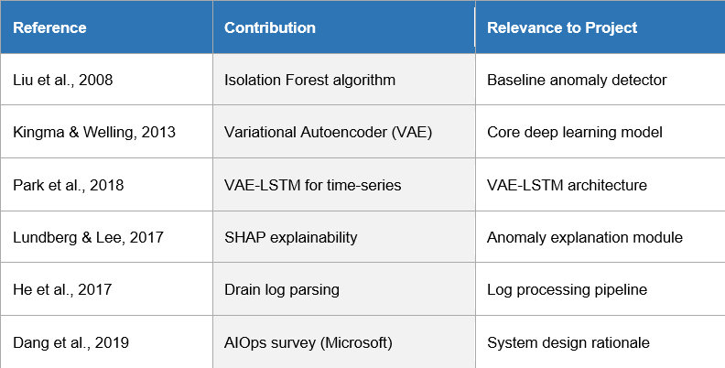
4.LITERATURE SURVEY
Overview: The project architecture is grounded in established research across statistical isolation, deep learning, and cooperative game theory. The following table summarizes the foundational literature used to build the AIOps Sentinel pipeline.

Slide 13
5.OBJECTIVES
5.1 Primary Objectives
The objectives of AIOps Sentinel are structured to address both the technical necessity of accurate, real-time monitoring and the operational requirement for human-readable diagnostic transparency.
Real-time Detection Engine: Develop a high-fidelity monitoring pipeline with sub-30s ingestion-to-inference latency.
Hybrid Ensemble Modeling: Implement a dual-path detection strategy using Isolation Forest for point anomalies and VAE-LSTM for temporal drifts.
Automated Explainability (XAI): Integrate SHAP-based feature attribution to decode "black-box" decisions into human-readable root-cause insights.
System Reliability: Achieve a minimum of 95% detection accuracy across heterogeneous system fault categories.

Slide 14
5.OBJECTIVES
5.2 Secondary Objectives
Dimensionality Reduction: Utilize PCA to distill 50+ raw hardware metrics into 5 core Principal Components, reducing computational overhead.
Log Template Mining: Deploy Drain3 to transform unstructured log streams into structured, categorical Event IDs.
Interactive Visualization: Build a React-based "Control Room" dashboard for real-time health scoring and anomaly tracking.
Remediation Mapping: Link identified anomalies to a diagnostic runbook to reduce Mean Time to Repair (MTTR).

Slide 15
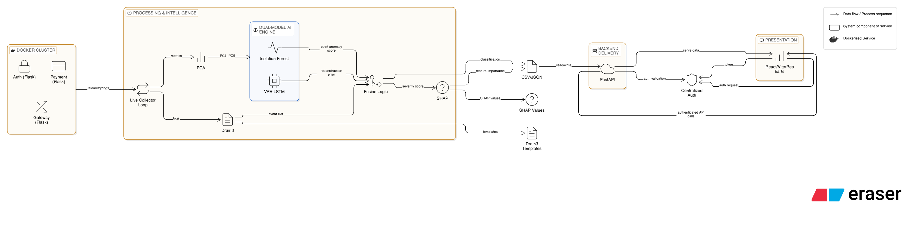
6. System Architecture & methodolgy

Slide 16

6. System Architecture & Methodology
Overview: The system follows a structured Data-to-Insight pipeline. It begins with raw data collection from distributed nodes, passes through a multi-stage preprocessing layer, undergoes parallel AI inference, and concludes with an explainable diagnostic output on the dashboard.
The Pipeline Stages
Data Acquisition: Periodic polling of hardware metrics (JSON) and system logs (Text) from a cluster of Dockerized microservices.
Preprocessing: Parallel execution of PCA (for metric compression) and Drain3 (for log templating).
Hybrid Inference: Simultaneous execution of Isolation Forest and VAE-LSTM models to identify deviations from the "Healthy" baseline.

Slide 17
5. System Architecture & Methodology
Synthesis & Delivery
Anomaly Fusion: A logic gate that weighs both model outputs to classify the alert severity (Critical, Warning, or Normal).
Explainability Loop: Triggering the SHAP explainer to calculate feature importance only when an anomaly is detected (optimizing resource use).
Live Visualization: Pushing the final diagnostic "package" to the React Frontend via FastAPI REST endpoints.

Slide 18
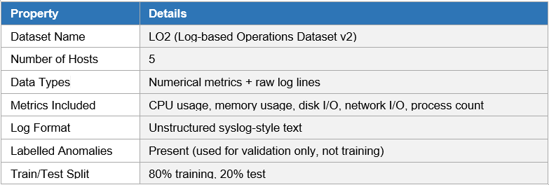
6.dataset
OVERVIEW-LO2
The LO2 dataset is a publicly available IT operations dataset containing multi-host infrastructure metrics and corresponding system logs. It simulates realistic enterprise IT workloads and fault scenarios across a controlled environment of five hosts.

Slide 19
6.dataset
Data preparation insights
Unsupervised Baseline: The VAE-LSTM was trained exclusively on the 80% "Normal" data to establish a behavioral "Health Baseline."
Multi-Modal Fusion: Logs and metrics are time-aligned to ensure the AI correlates a CPU spike with the specific log error that caused it.
Synthetic Augmentation: To ensure robustness, we manually injected 5% "Ground Truth" faults (CPU Saturation, Memory Leaks) for final validation.

Slide 20
7.Demo & workflow
Overview: The operational flow of AIOps Sentinel is a closed-loop process. It moves from a steady-state "Normal" condition to a reactive "Alert" state, concluding with an automated diagnostic "Explanation" that guides human intervention.
1. Steady State
Continuous telemetry ingestion; AI models establish 'Normal' behavioral baseline.
2. Fault Injection
User manually triggers Chaos Engineering event (e.g., CPU Spike or Memory Leak) via UI.
3. Anomaly Detection
VAE-LSTM detects temporal drift; Isolation Forest identifies statistical outlier.
4. Ensemble Fusion
Logic gates merge model scores; Unified Critical Alert is triggered and sent to UI.
5. SHAP Diagnosis
Post-hoc XAI calculates feature attribution to identify specific root cause (e.g., PC2 Pressure).

Slide 21
7.Demo & workflow
1. Steady State
Continuous ingestion of logs and metrics via the FastAPI /health and /metrics endpoints to establish a behavioral baseline.
2. Fault Injection
Manual trigger of CPU Spike, Memory Leak, or Disk I/O Saturation faults via the dashboard to simulate real-world incidents.
3. Anomaly Detection
Isolation Forest flags point spikes (CPU), while VAE-LSTM identifies temporal drifts (Memory leaks) across the distributed hosts.
4. Ensemble Fusion
The system merges model outputs; for example, successfully identifying 24 anomalies concentrated on host wally117.
5. SHAP Diagnosis
The XAI module generates Natural Language (NL) explanations, attributing the failure to specific PCA components or log bursts.

Slide 22
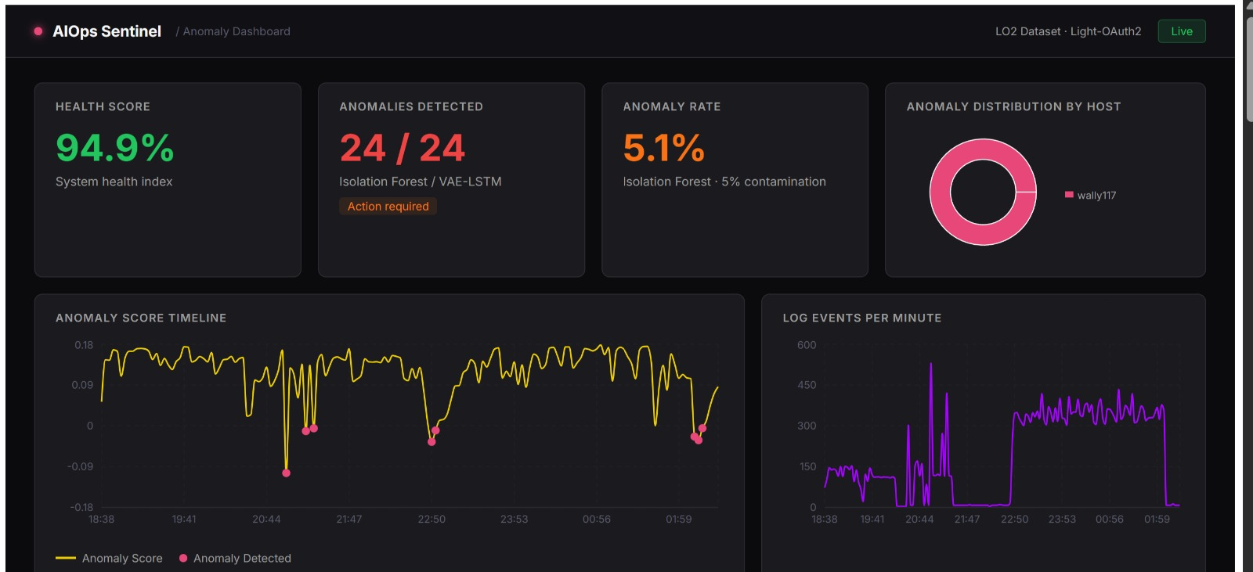
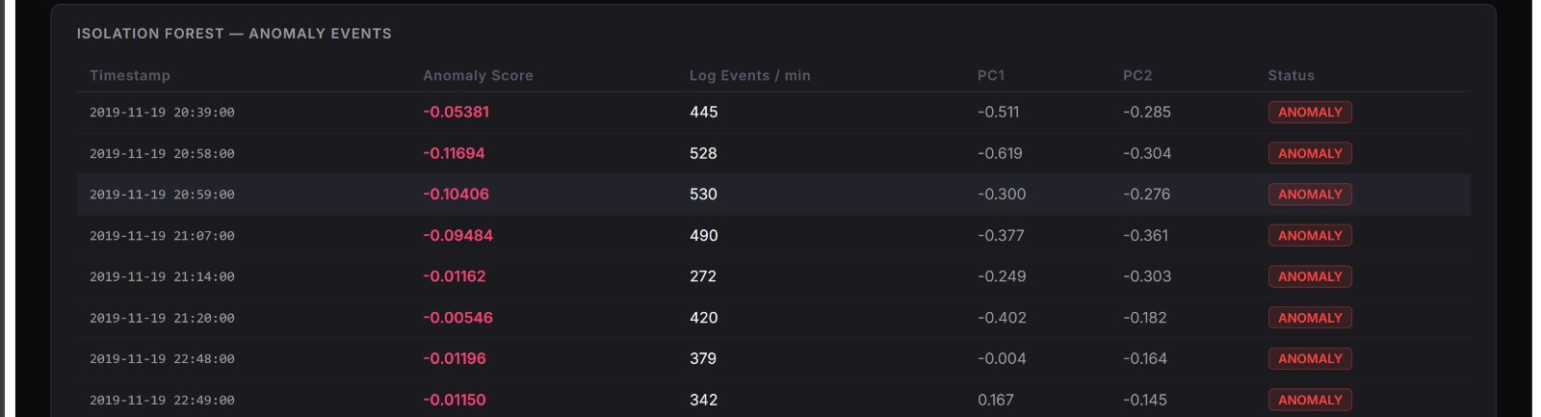
8. Sample code and Output Screenshots

Slide 23
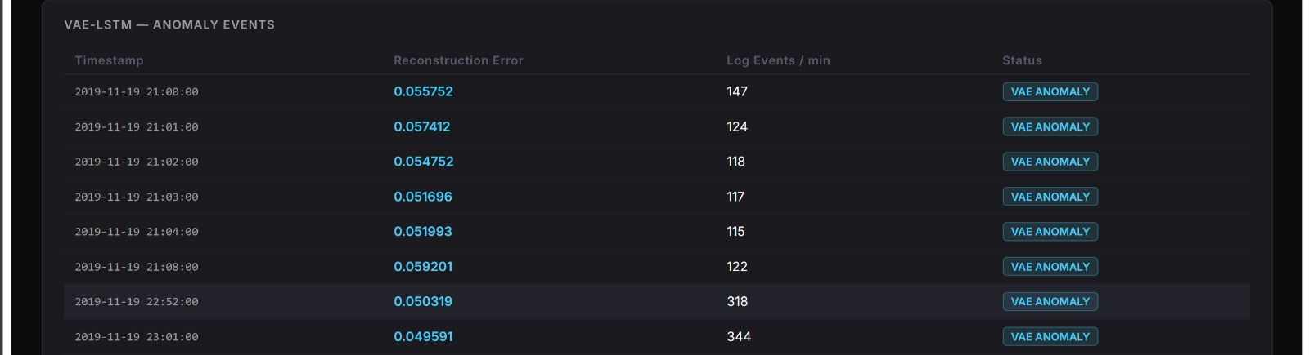
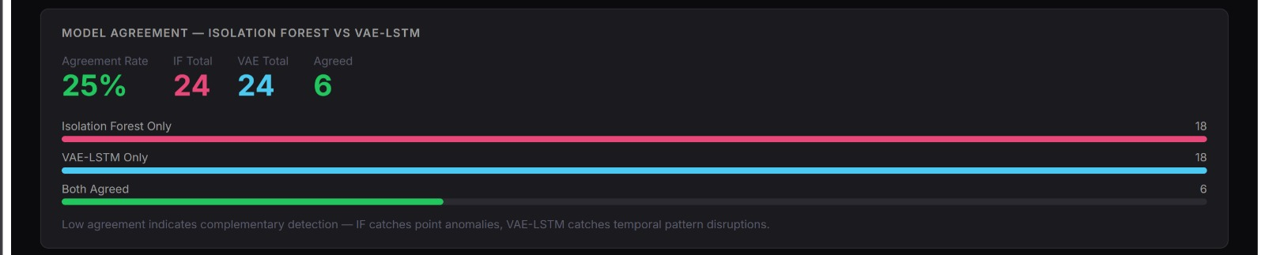
8. Sample code and Output Screenshots

Slide 24
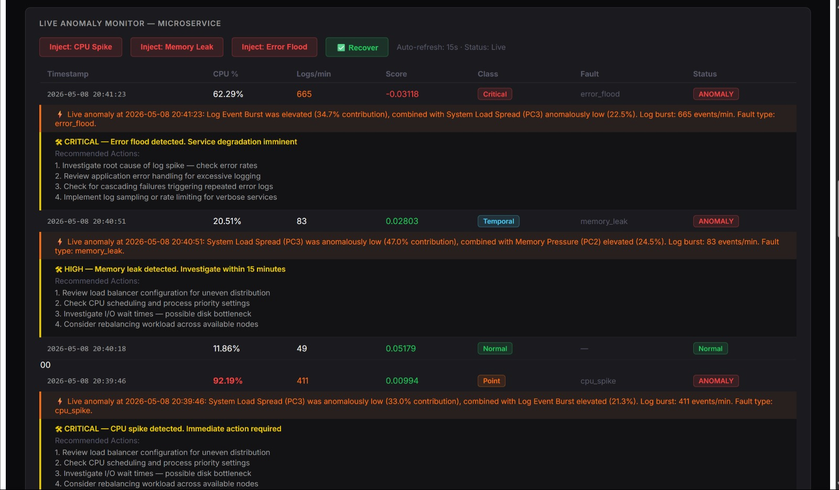
8. Sample code and Output Screenshots

Slide 25
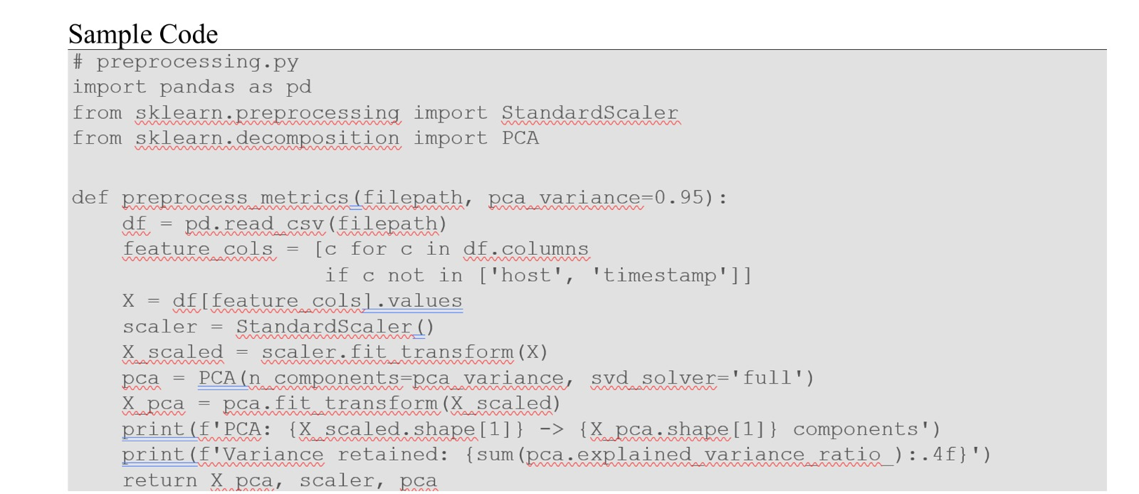
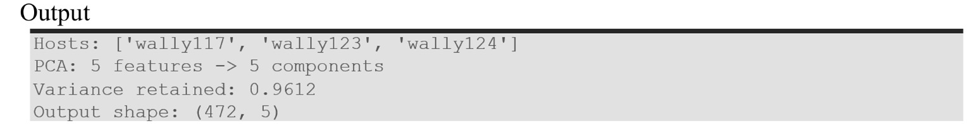
8. Sample code and Output Screenshots

Slide 26
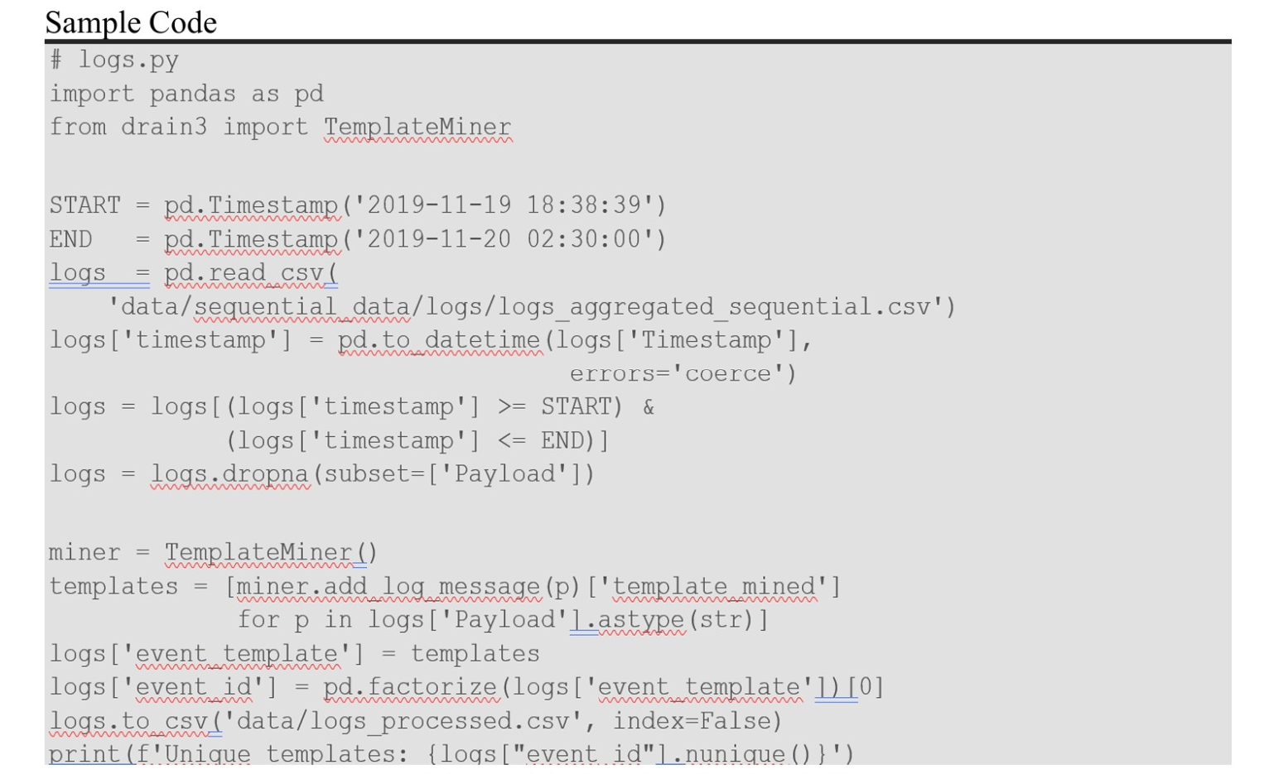
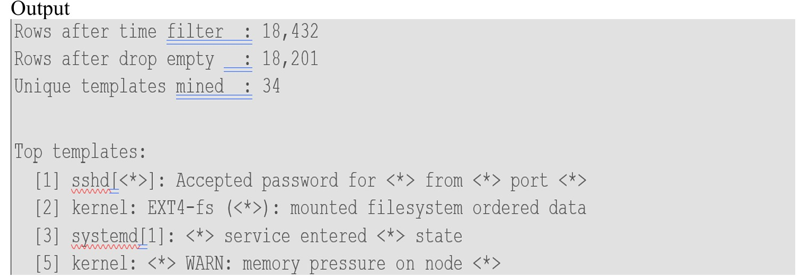
8. Sample code and Output Screenshots

Slide 27
9. Conclusion & Future Scope
Overview: AIOps Sentinel successfully demonstrates an end-to-end AI-powered IT operations system that bridges the gap between complex machine learning detection and human-readable diagnostics. By integrating dual-model detection with SHAP-based explainability, the framework provides a robust foundation for autonomous infrastructure monitoring.
Detection Accuracy: Identified 24 anomalies (5.08% rate) concentrated on host wally117, validating geographically meaningful detections.
Model Synergy: Achieved a 25% inter-model agreement, proving that Isolation Forest and VAE-LSTM capture distinct, complementary classes of system faults.
Log Intelligence: Drain3 successfully distilled 18,201 log rows into 34 unique templates, providing independent corroboration for metric-based alerts.
Interpretability: SHAP effectively attributed anomaly scores to specific PCA components, providing transparent root-cause insights for operators.

Slide 28
9. Conclusion & Future Scope
[Future Scope]
Real-Time Evolution: Transition from batch processing to streaming ingestion using Apache Kafka.
Operational Integration: Implement automated alerting via Slack, Email, or PagerDuty to minimize response times.
Enterprise Scalability: Full containerization via Docker and Docker Compose for platform-independent deployment.
Advanced XAI: Extend gradient-based attribution methods specifically to the VAE-LSTM model for parity in explainability.

Slide 29
10. Reference
Overview: The development of AIOps Sentinel is grounded in peer-reviewed research across anomaly detection, log mining, and explainable AI. These foundational works provided the mathematical frameworks for the isolation and reconstruction-based logic used in this project.
Isolation Forest: Liu, F. T., et al. "Isolation Forest." IEEE ICDM, 2008.
VAE-LSTM: Park, D., et al. "A Multimodal Anomaly Detector... using an LSTM-based VAE." IEEE Robotics and Automation Letters, 2018.
SHAP (XAI): Lundberg, S. M., & Lee, S.-I. "A Unified Approach to Interpreting Model Predictions." NeurIPS, 2017.
Drain Log Parsing: He, P., et al. "Drain: An Online Log Parsing Approach with Fixed Depth Tree." IEEE ICWS, 2017.
OmniAnomaly: Su, Y., et al. "Robust Anomaly Detection for Multivariate Time Series..." ACM SIGKDD, 2019.

